Slide 1
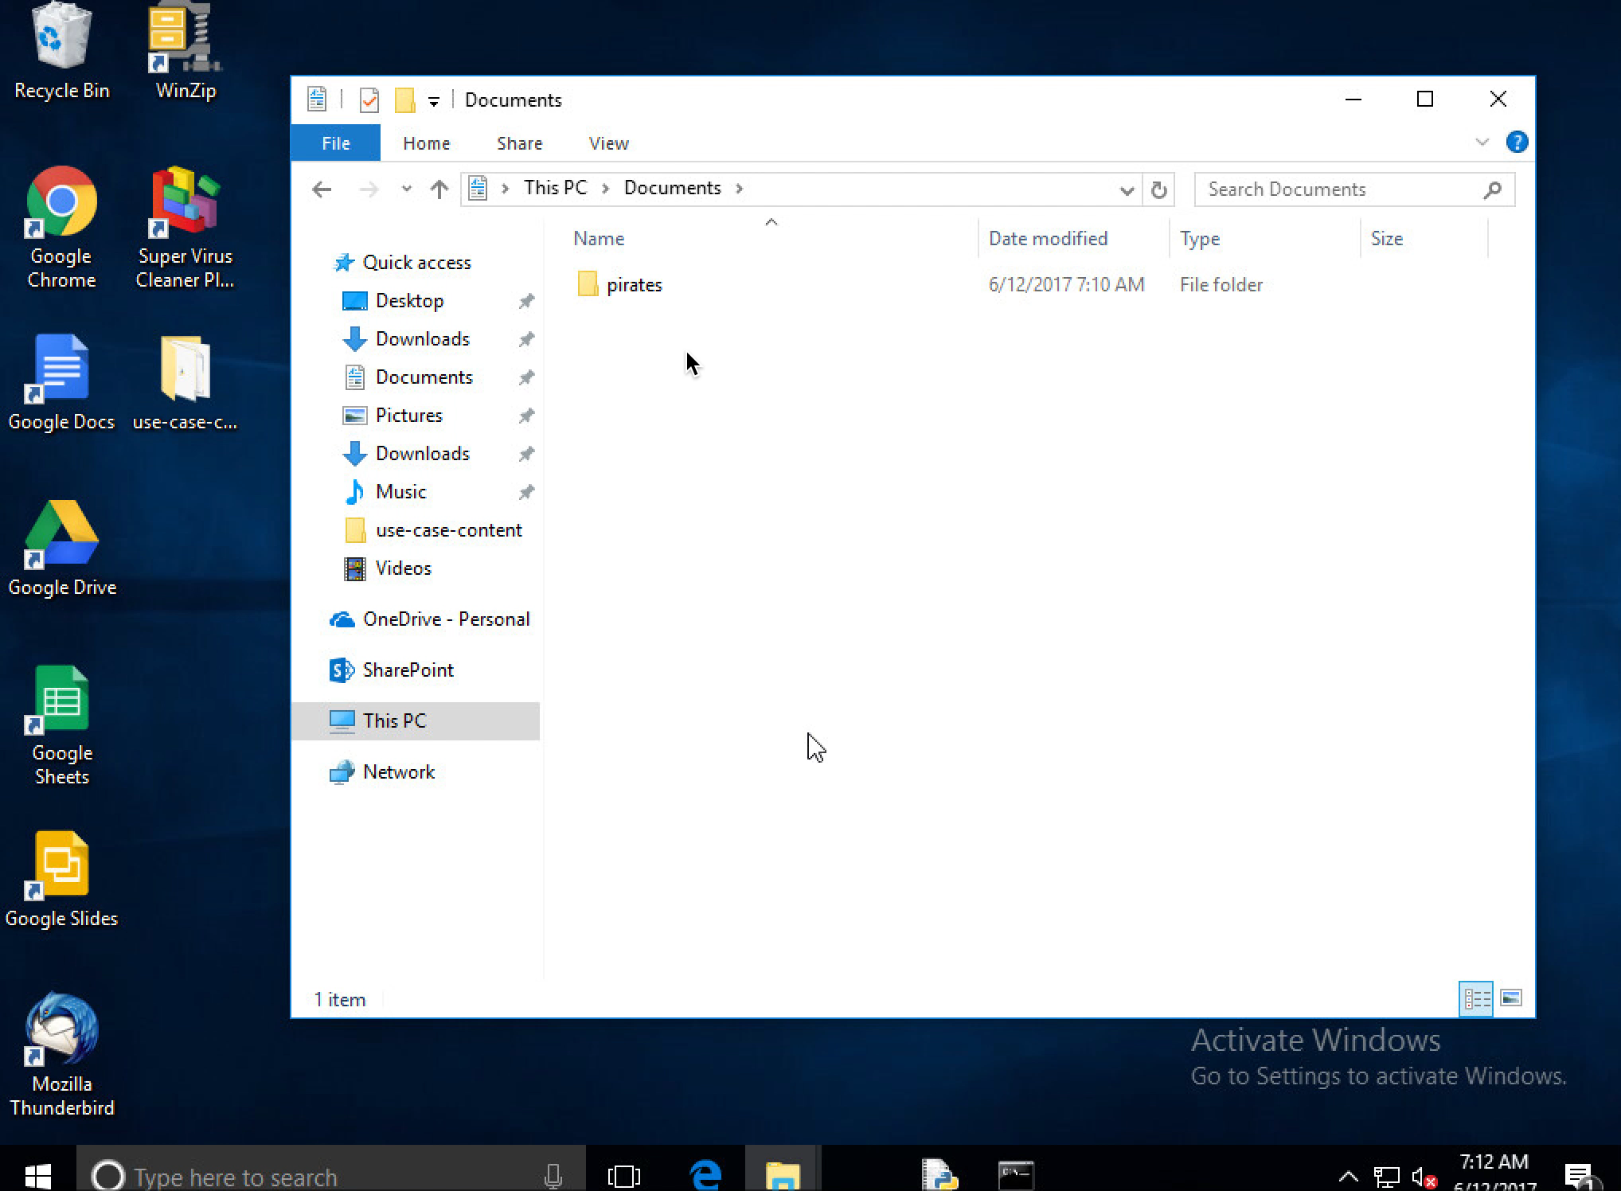
Demo RANSOMWARE
Notes:
-An end user in a corporate environment store his files (both professional and personal) in the “My Documents” folder of his work computer.
-Noticing his computer has been running slower than usual, he downloads a virus cleaner from the internet in an attempt to remediate the problem.
-Upon running the downloaded software, a notice pops up that his computer has been infected with ransomware (malicious software that encrypts computer files and extorts money in exchange for the decryption key).
-The user confirms that his files are indeed unopenable.

Slide 2
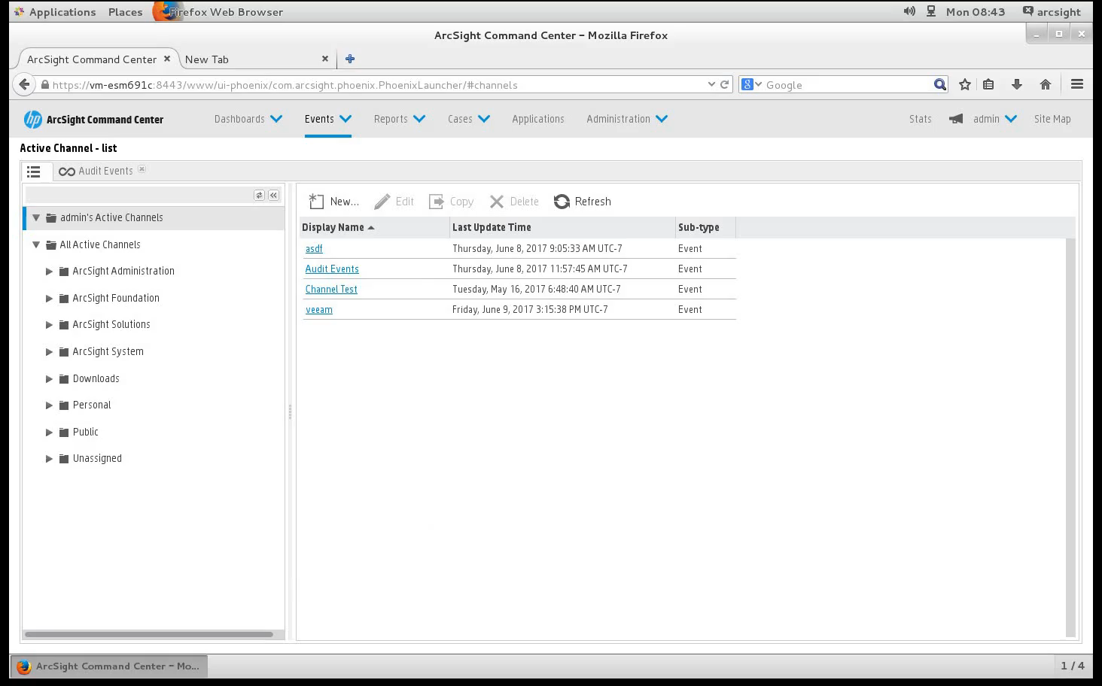
Demo Ransomware recovery
Notes:
-The end user calls IT, who accesses and inspects the logs in the ArcSight Command Center.
-IT is able to see the changes made by the executable.
-Thankfully, the end user machine has been routinely backed up by IBM Spectrum Protect.
-IT uses the IBM Spectrum Protect Backup-Archive Client to restore the encrypted files to their last known good state on the end user machine (this action can also be executed remotely by IT).

